Slide 1


BUSINESS CASE: CLIENT RETENTION SOLUTION
Consultant Group 3
Sai Krishna Reddy Koppula
Pratik Nesarkar
MacKenzie Emerson
Vatsa Kala
Andrew Shelton
Aidan Schwartz
Texas A&M University | April 21, 2025

Slide 2









KEY CHALLENGES
GAPS IN CURRENT PROCESSES
PROPOSED SOLUTION
EXPECTED BENEFITS
EXECUTION PLAN
Primary Goal:
RISKS & ASSUMPTIONS
Client Retention

Slide 3






Client Retention
Maintenance & Service Quality Issues
Identify Tenants at Risk of Non-Renewal Using Existing Data
Key
Challenges
Recurring Maintenance Issues or Critical Outages
Tenants Feel Unheard

Slide 4








Gaps in the Current Process
Unclosed Loop [Insights to Execution]
Inconsistent Property Manager Performance
Reactive Maintenance Rather Than Proactive
Resolution Provided but No Pattern Analysis
No Visibility of Resolution Timeline to Tenants

Slide 5
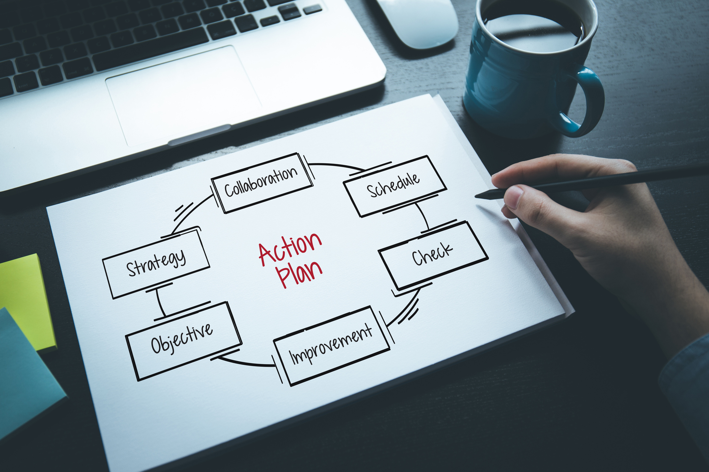





Next Best Action (NBA) System
Data Analytics & Identification of Best Actions
Continuous Training from Manager Performance & Customer Feedback
Ticket Progress Notifications for Tenants
Automation of Issues & Increase in Proactive Solutions
Dashboard Integration within Current CRM System
Next Best Action (NBA)
Visualizations of Tenant & Property Data (Using PowerBi)
Listing of Open Tasks & Tickets
Notes:
Communicate: NBA means “best action a property manager should take next, based on data.”

Slide 6

Next Best Action (NBA)
Existing CRM System
Next Best Action System
User Actions & Process Changes
System Inputs
Issue Segmentation
System Generated
Next Best
Action
Automatic Action
Manager Action
Simple
Medium
Complex
Historical Data
+
Real-Time Data
Manual Update
Automated Update
Tenant/Customer Notification

Slide 7
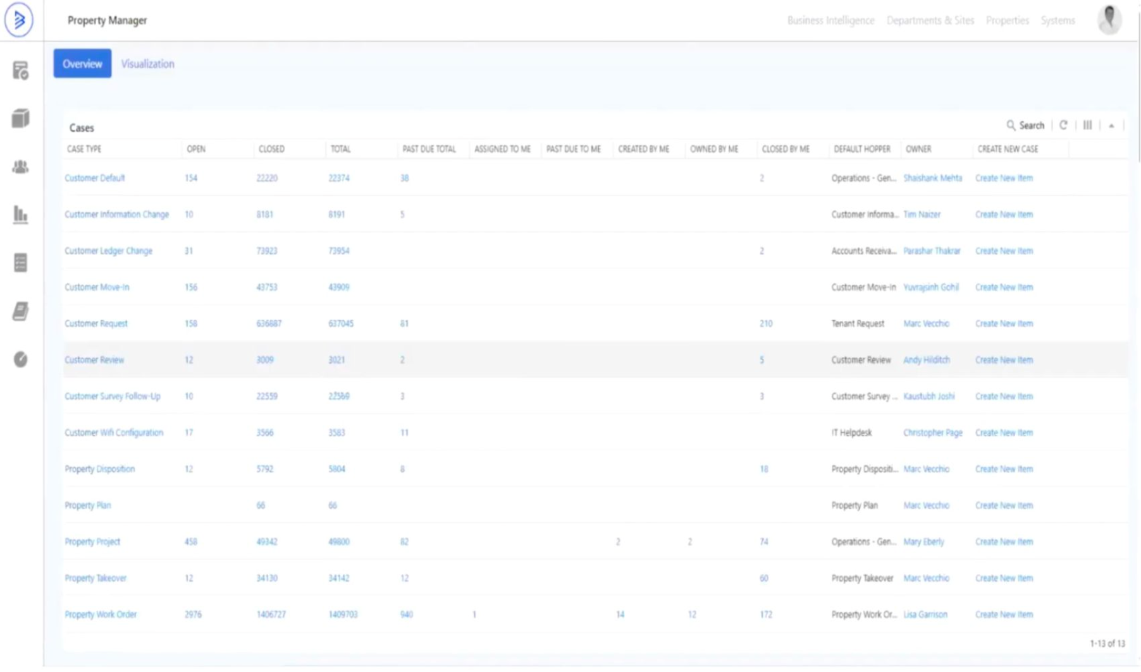
Existing Dashboard

Slide 8
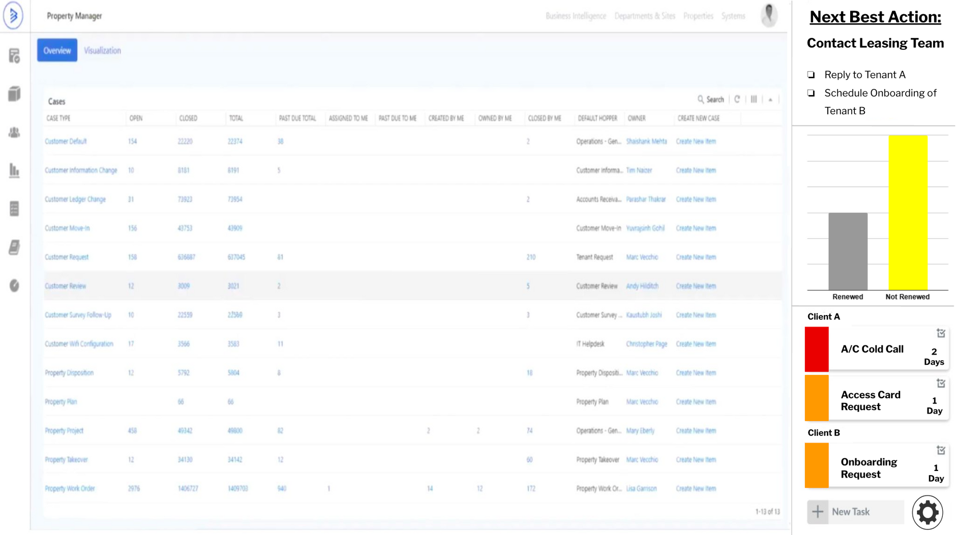
Proposed Dashboard Integration
Notes:
Not aiming to change the current dashboard, instead just add new panel with actions and insights.
Provides brief summary overview for managers.

Slide 9





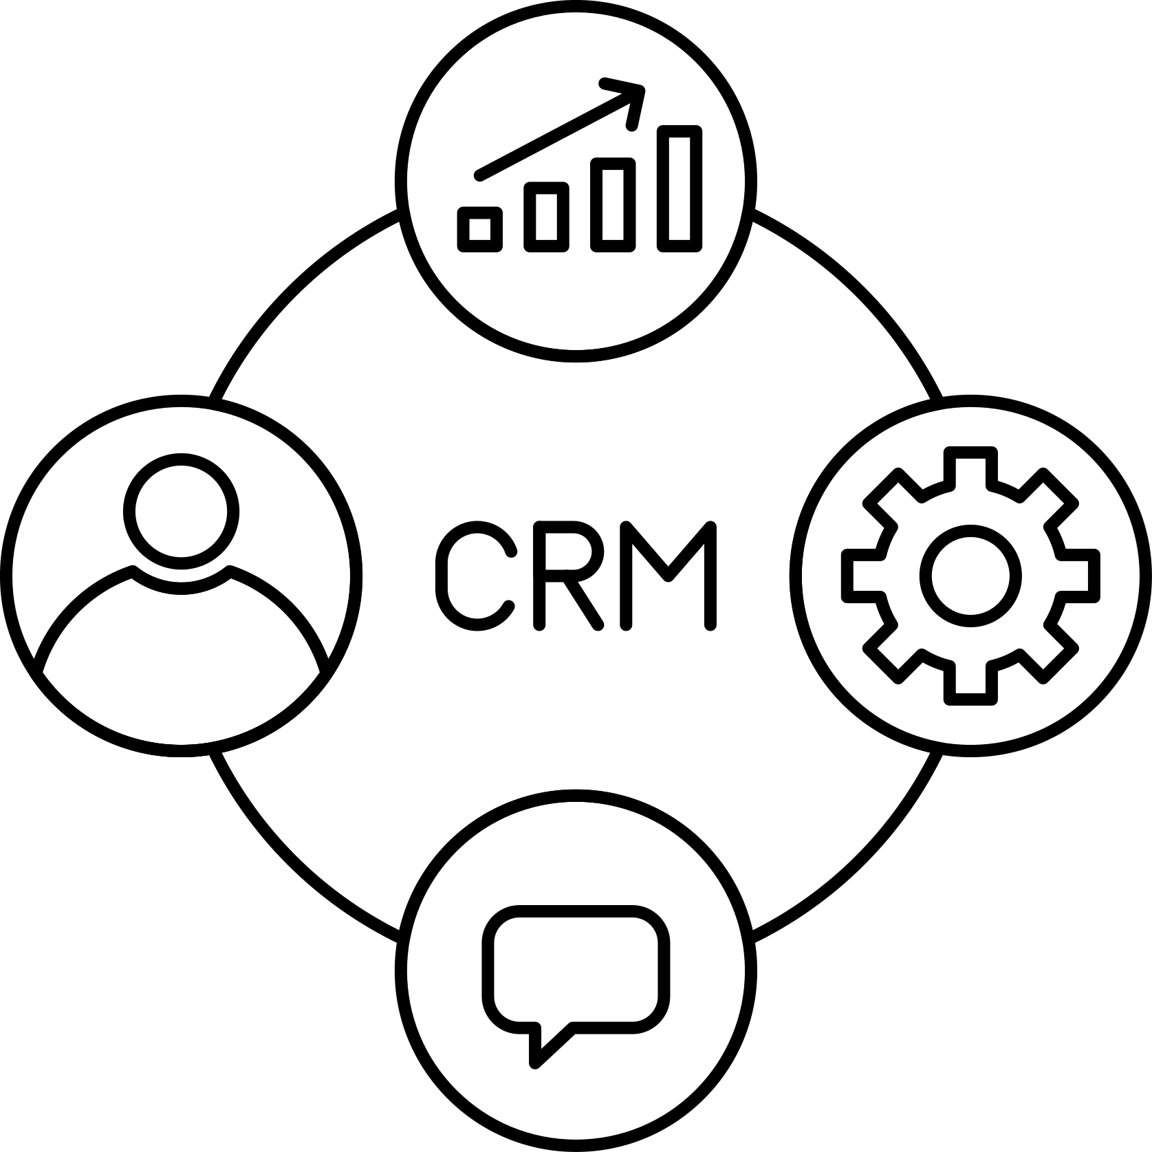
Underlying Technology
Quick Add-on
Automated Client Notification
Actionable Insights for dashboard
Next Best Action Engine
Data Ingestion Module
LLM + Analytics Engine
Boxer Properties Existing CRM

Slide 10










Execution Plan
Phase 1: Tenant Feedback Integration
Implement email updates to inform tenants about ticket progress and collect feedback while NBA is being developed.
Timeline: 4 Weeks
Phase 2: NBA System Development
Developing Implementing the proposed Next Best Action System and integrating it with CRM dashboard.
Timeline: 10 Weeks
Phase 3: Pilot Deployment in Houston
Deploy the NBA system in Houston buildings and gather manager/tenant feedback.
Timeline: 16 Weeks
Phase 4: Feedback and Full Rollout
Refine the system based on pilot insights and expand to additional cities
Timeline: 17-24 Weeks

Slide 11




The Property Manager
Raised Baseline Manager Performance
Benefits
Informed Decision Making like Never Before
Seamless Integration with No Training Required

Slide 12






The Client
Improved Visibility of Issue Resolution Timeline
Benefits
Enhanced Service Quality

Slide 13



The Ultimate Benefit: Boxer Property
Higher Renewal Rates
Increased Customer Satisfaction
Lower Overall Operational Cost
Improved Loyalty
Cost-Effective Implementation

Slide 14

Risks & Assumptions
Property Managers Hesitance Towards Change
Data Quality & Inconsistency for Insights
Use Test Group as a Trial Period for NBA System
Test Group can Serve as Training Group
Enabling and Using Automated NBA System, Further Down the Road

Slide 15
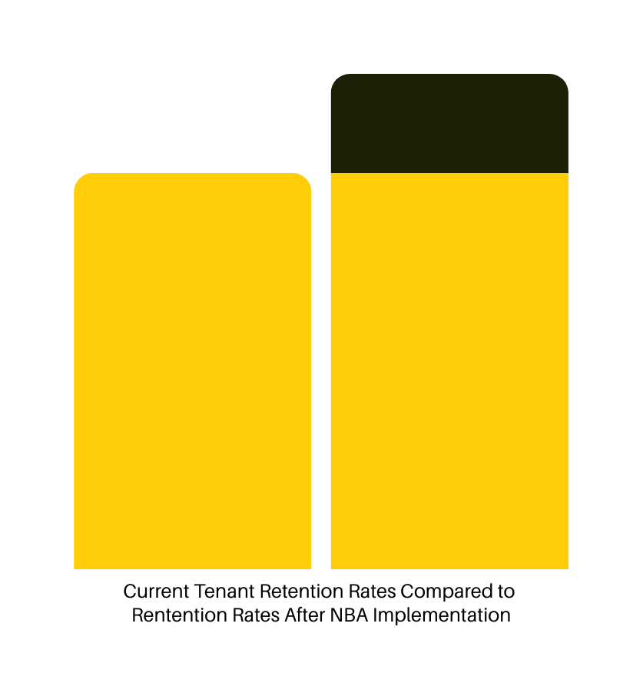



Before
After
Summary
Current Goal → Improve Current Customer Retention
Current Challenge → Inconsistent Manager Performance
How We Get There → NBA System & Dashboard Integrations
Retention
Implementation of NBA System
Consistency of Manager Performance
Greater Current Tenant Satisfaction
and Renewal Rates

Slide 16


Thank you!
We look forward to helping Boxer Property
unlock smarter decisions & stronger tenant relationships.
Texas A&M University | April 21, 2025

